Slide 1
AIR QUALITY TRENDS AND POLLUTION ANALYSIS IN MAJOR CITIES

Slide 2
Introduction
Air pollution is a critical global health threat, causing 7–8 million deaths annually (WHO).
Main sources: Urbanization, industrial activity, vehicle emissions.
Affects environment and leads to respiratory & cardiovascular issues.
Key pollutants: PM2.5, NO₂, CO, SO₂, O₃ – highly concentrated in cities.
This project analyzes air quality in major global cities using interactive visualizations.
Tracks AQI trends, pollutant levels, and weather influences (temperature, humidity, wind).
Investigates:
Most polluted cities & seasonal patterns.
Differences between weekday vs weekend pollution.
Effectiveness of regulatory interventions.
Interactive dashboards make complex pollution patterns understandable, enabling informed, data-driven decisions for healthier urban planning.

Slide 3
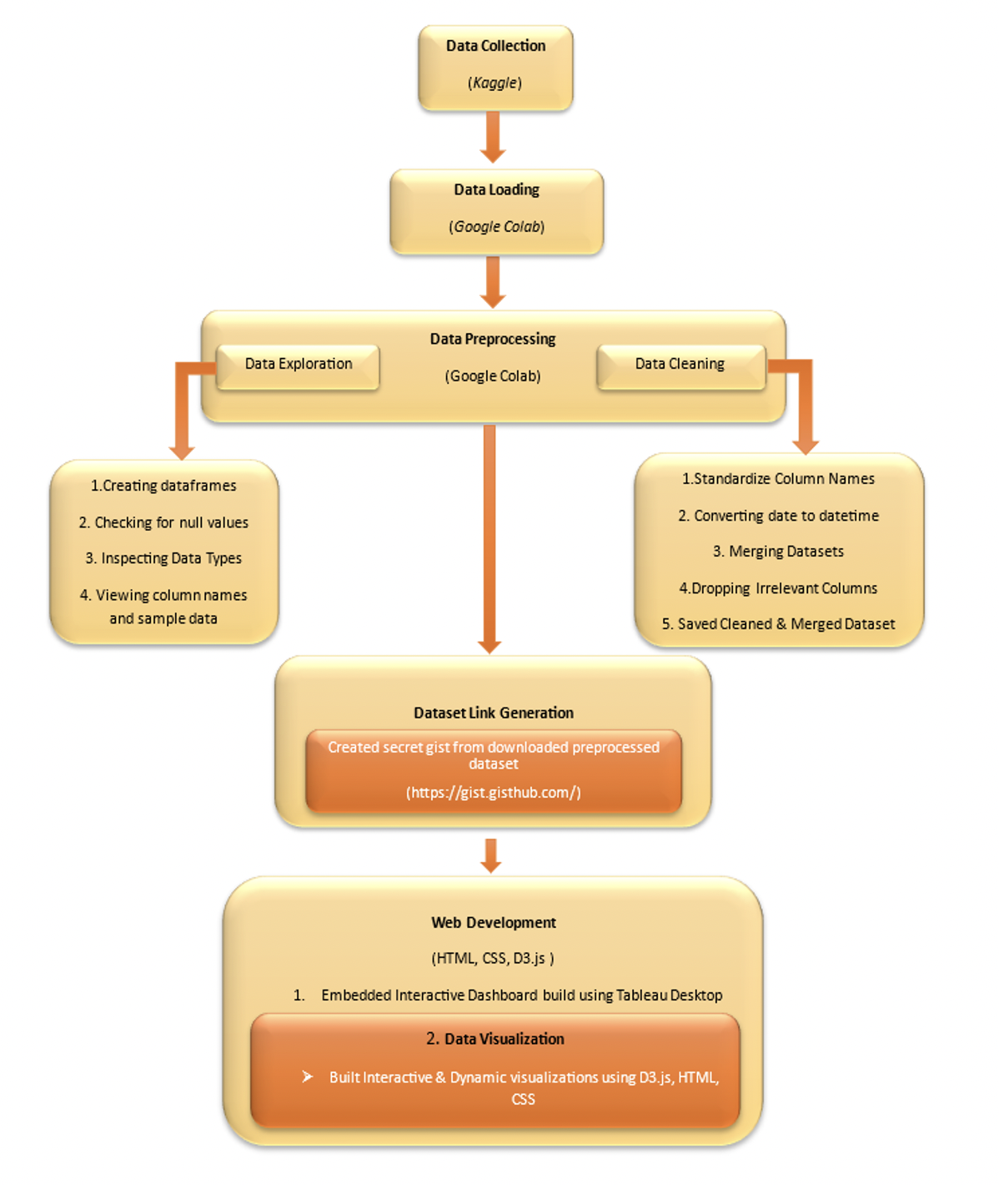
Methodology
Datasets sourced from Kaggle and uploaded to Google Colab for exploration and transformation.
Explored each dataset individually using Pandas: checked datatypes, null values, and column similarities.
Standardized column names, converted date fields, and merged datasets on country, city, and date.
Removed irrelevant columns and saved the cleaned, merged dataset.
Final dataset uploaded to gisthub to create a secret gist and generate a shareable dataset link
Dataset link: https://gist.githubusercontent.com/Shivani-198/f1f77ad7a8f621cb1c2efed4722eeb11/raw/9f771e7cc45be57850b6000da3f36fe9d486049d/gistfile1.txt

Slide 4
Implementation
Tableau Desktop: Used for creating interactive dashboards to visualize air quality trends by city, season, and pollutant type. Included features like filters, heatmaps, and dual-axis plots.
Tableau Public: Dashboards were published online for browser-based interaction using a Tableau Public account.
HTML: Provided the structure and layout for dashboards (e.g., charts, buttons, menus).
CSS: Styled the interface for a modern, clean look, with hover effects, spacing, and visual consistency.
D3.js: Core library for creating interactive, data-driven charts (bar plots, heatmaps, animations) with tooltips, sliders, and dynamic behavior.

Slide 5
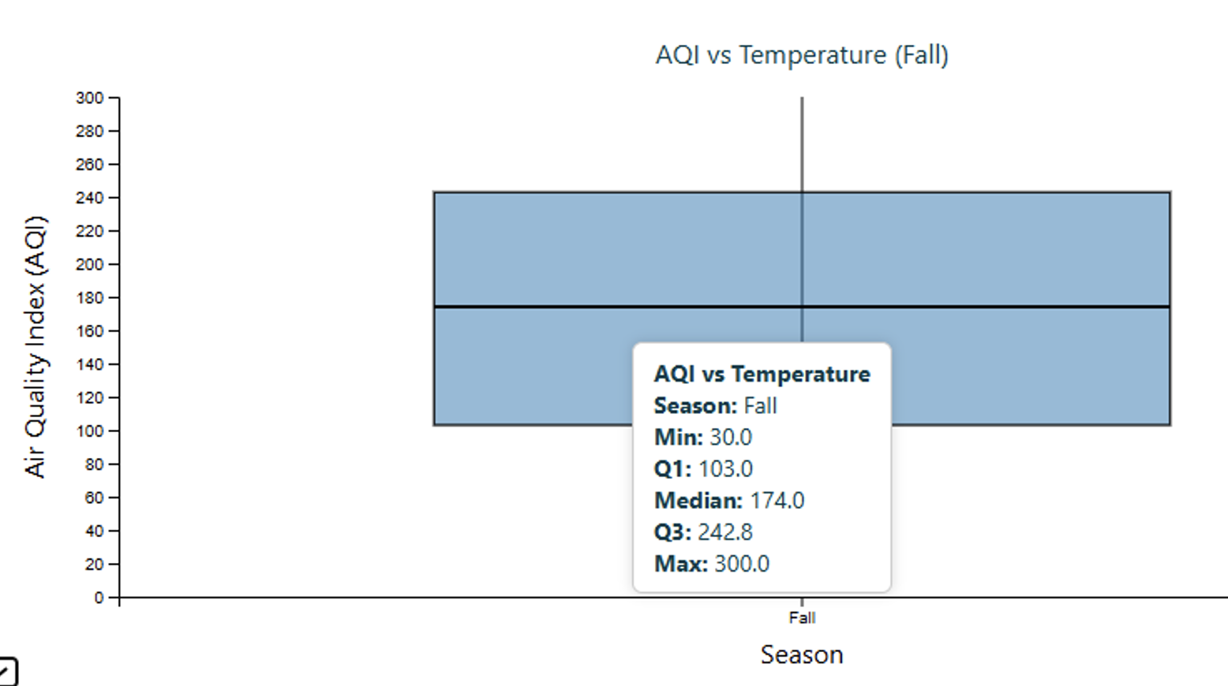
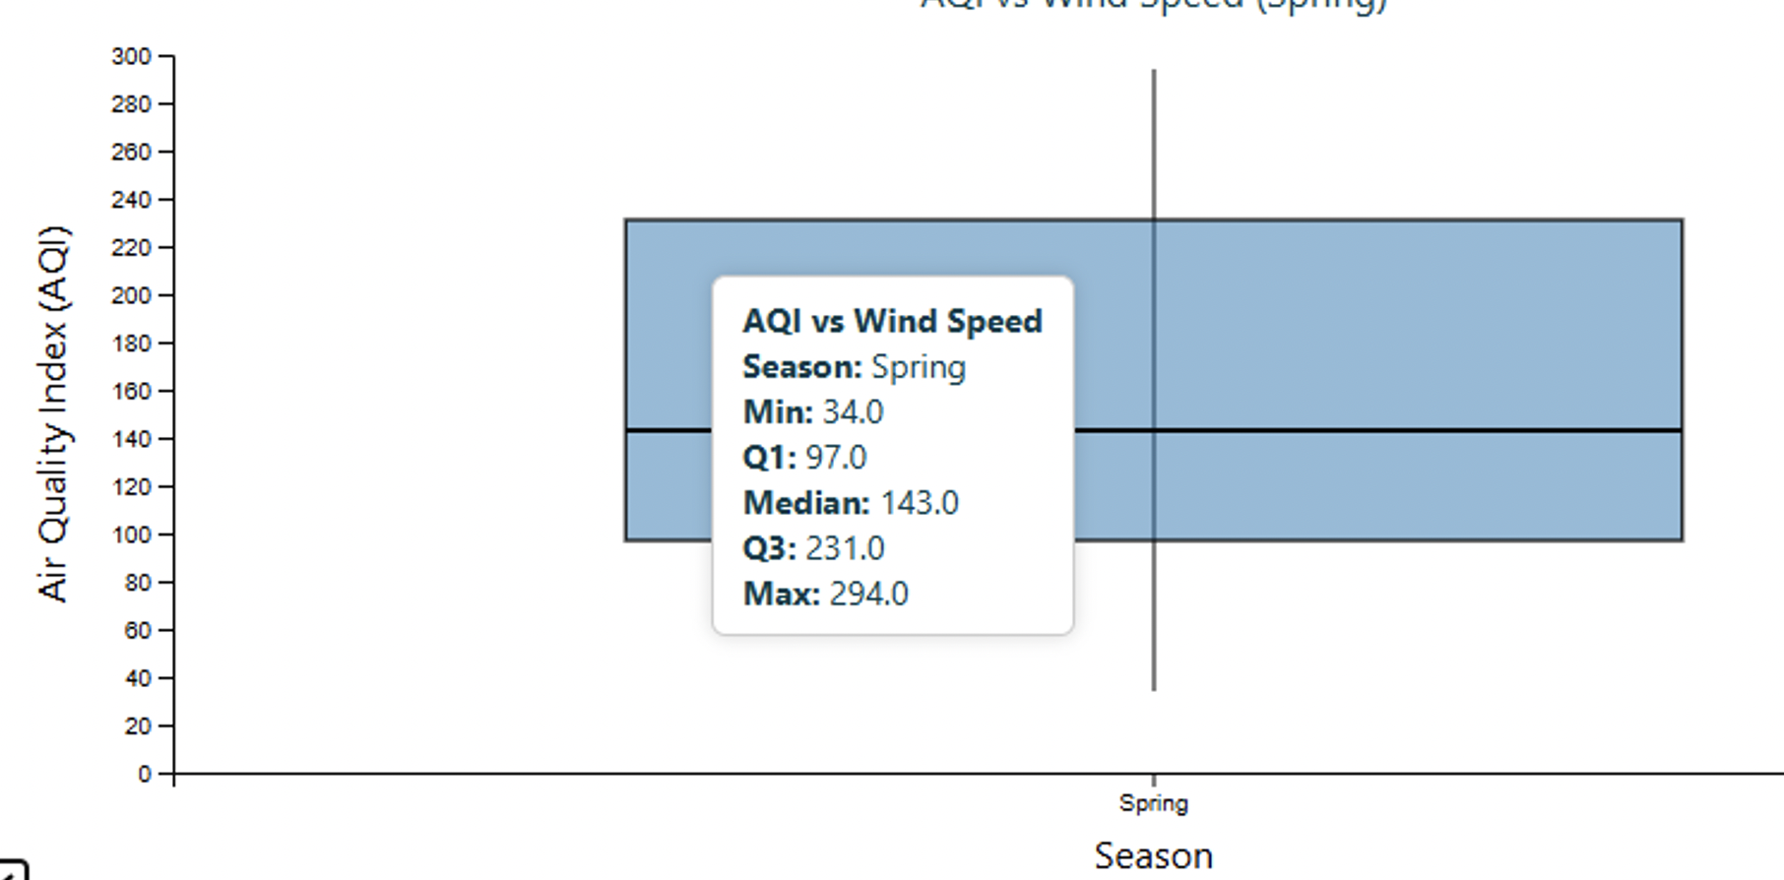
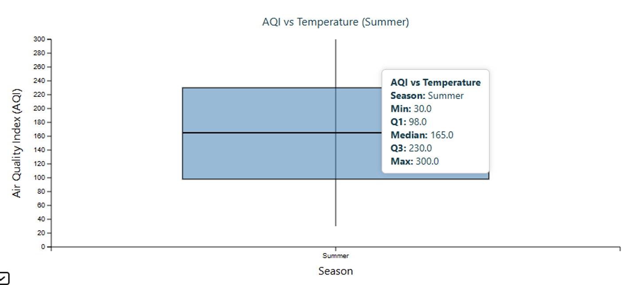
Visualizations – Box Plot
How do weather variables (temperature, humidity, wind speed) affect pollution levels across different seasons?
Median AQI rises across seasons: Spring: 143, Summer: 165, Fall: 174.
This suggests air quality tends to worsen as the year progresses.
Fall has the highest Q3 (242.8), indicating a larger portion of high AQI values compared to Spring and Summer.

Slide 6
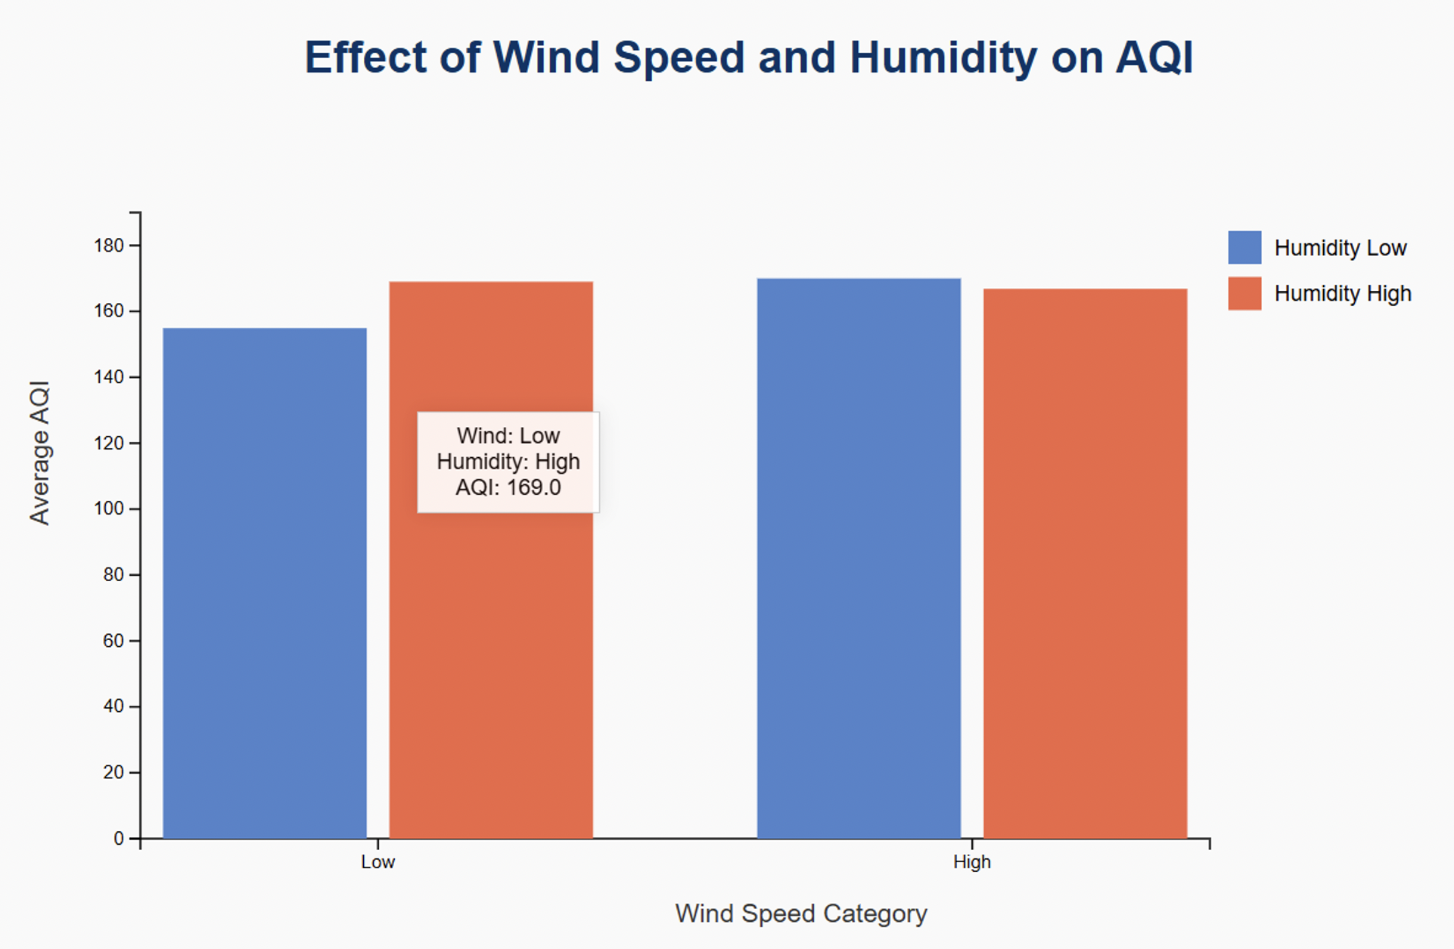
Visualizations – Bar Chart
Do low wind speed and high humidity conditions lead to higher AQI values?
The bar corresponding to Low Wind + High Humidity shows an AQI of 169.0, the highest among all combinations.
This indicates that stagnant air (low wind) combined with moisture (high humidity) worsens air quality, likely due to pollutant trapping.

Slide 7
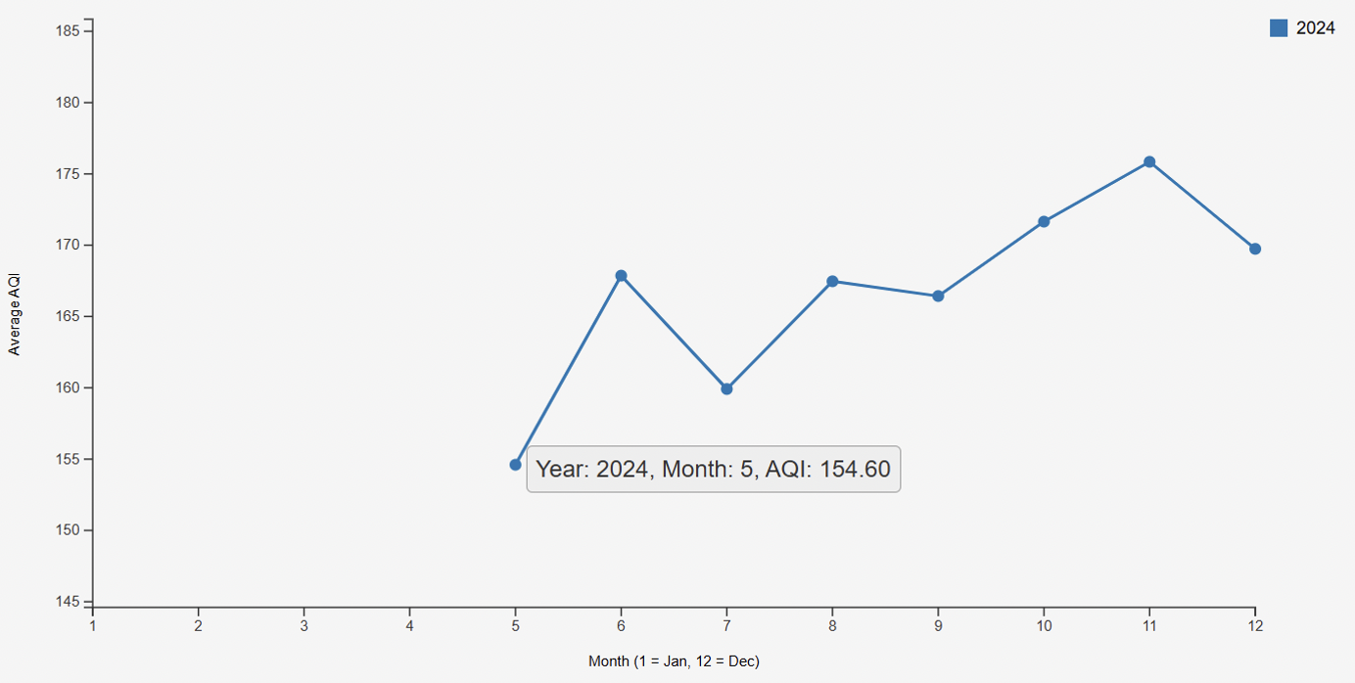
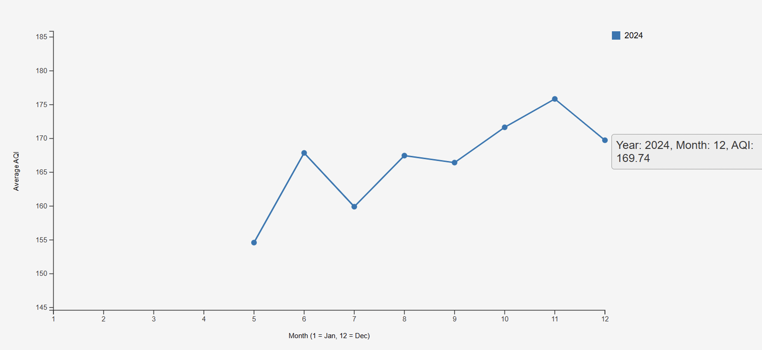
Visualizations- Grouped Bar Chart
Are pollution levels generally higher during winter months due to atmospheric inversion layers?
The line chart reveals that AQI levels tend to rise from mid-year toward the winter months, peaking around November and December.
This suggests that pollution levels are generally higher during winter, likely due to atmospheric inversion trapping pollutants near the surface.

Slide 8
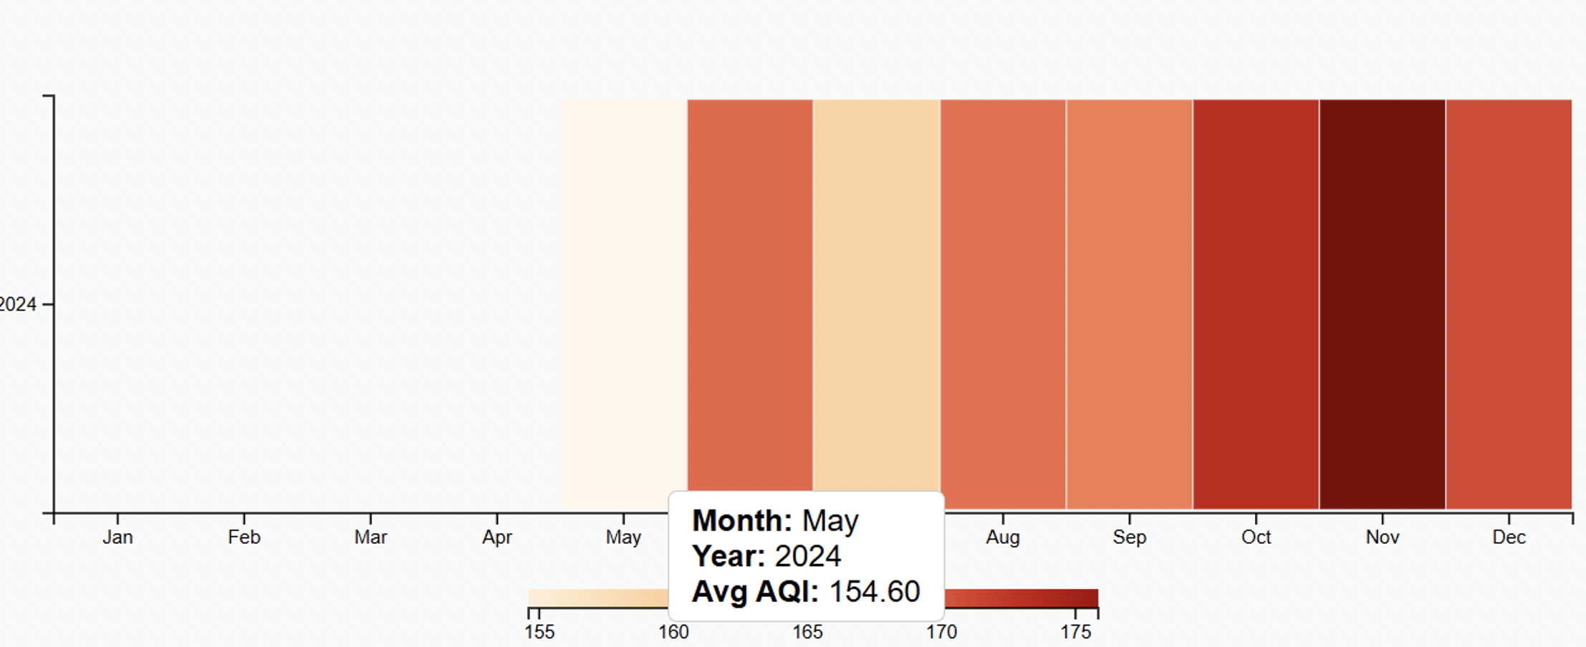
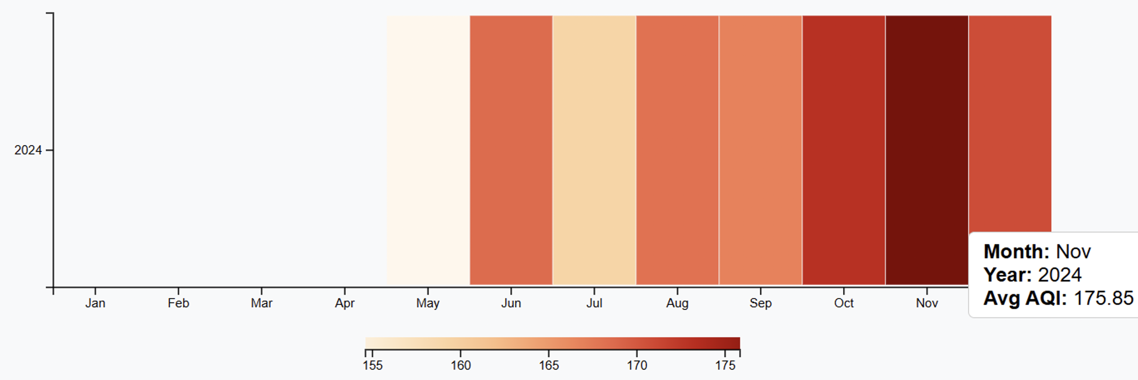
Visualizations- Heat Map
Are pollution levels generally higher during winter months due to atmospheric inversion layers?
The darker red shades in October (171.65 AQI), November (deepest red), and December (169.74 AQI) in the 2024 row reflect significantly higher pollution levels compared to earlier months like May (154.60 AQI), which has a much lighter shade.
The months corresponding to late fall and winter (Oct–Dec) consistently show elevated AQI values, visually reinforcing that colder months trap pollutants near the ground due to inversion layers, leading to degraded air quality.
The heatmap shows a clear increase in average AQI from May (154.60) to November (peak at ~175), indicating a seasonal rise in pollution levels as the year progresses toward winter.

Slide 9
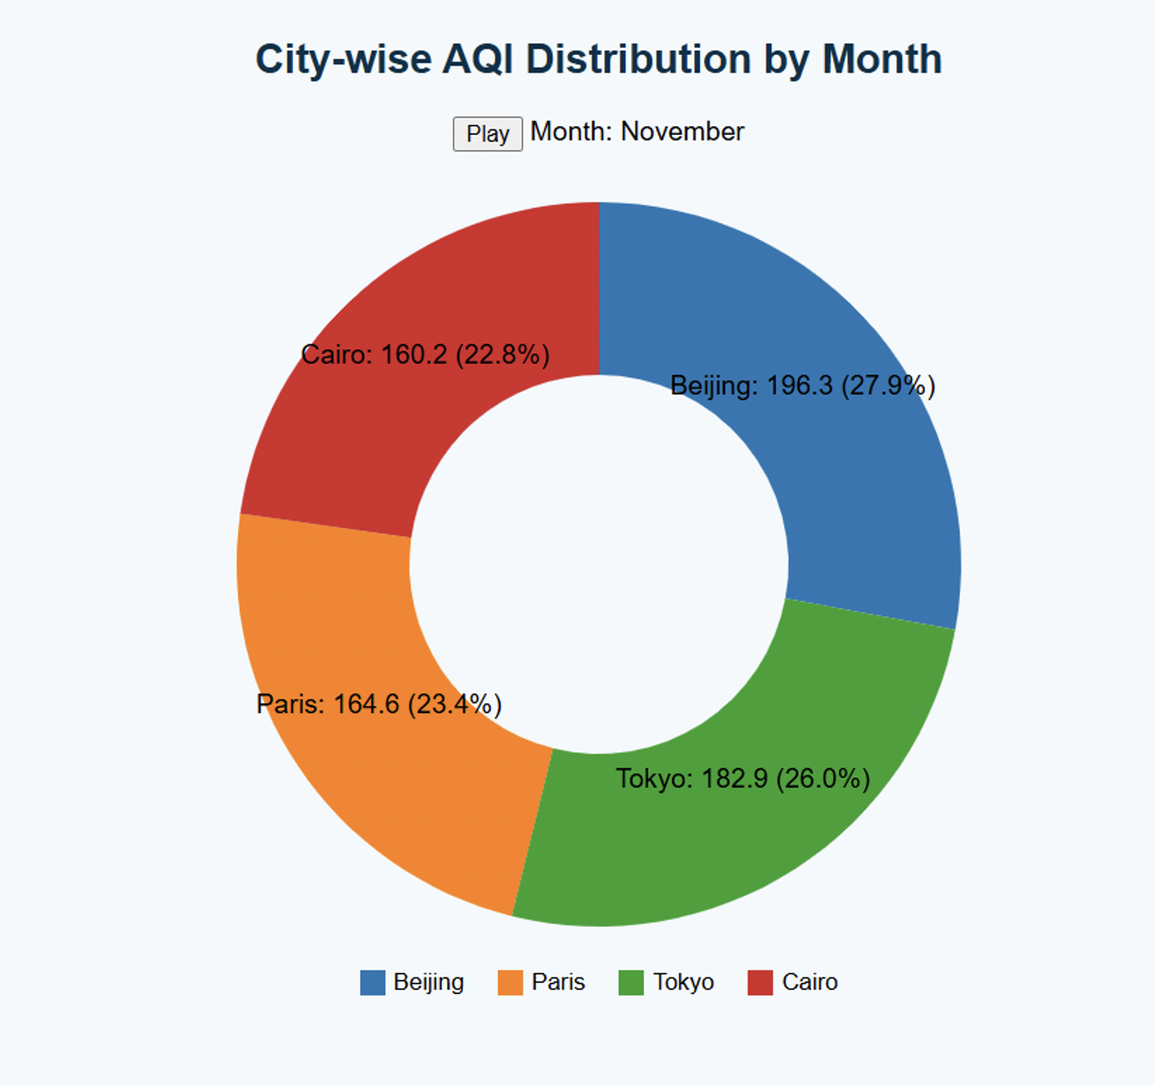
Visualizations- Pie Chart
Beijing Recorded the Highest AQI: With an average AQI of 196.3, Beijing contributed the largest share (27.9%) of the total air quality index among the four cities in November.
Tokyo and Paris Follow Closely: Tokyo: 182.9 AQI (26.0%)Paris: 164.6 AQI (23.4%) Both cities show elevated pollution levels, only slightly lower than Beijing.
Cairo Has the Lowest AQI Among the Four:
Cairo recorded the lowest average AQI (160.2), accounting for 22.8% of the distribution—though still indicating poor air quality.

Slide 10
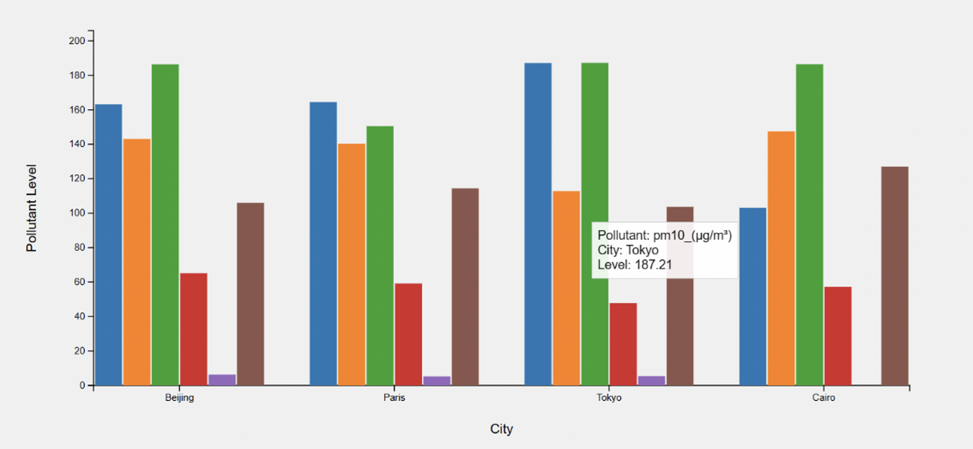
Visualizations
Which cities consistently exceed WHO-recommended air quality thresholds?
Major cities like Beijing, Tokyo, and Cairo, pollutant levels such as PM2.5, PM10, and O₃ visibly exceed WHO-recommended thresholds.
Tokyo emerges as a hotspot, with consistently high levels of AQI (187), PM10 (187.21), and O₃ (103.66), while Cairo and Beijing also show alarming readings across multiple pollutants.

Slide 11
Story Telling Approach
Understanding and Exploring the Dataset
Datasets Used:
Air Quality: 3,660 rows, 13 columns (includes AQI, PM2.5, PM10, NO₂, SO₂, CO, O₃)
Weather: 63,144 records, 41 attributes (temperature, humidity, wind, pressure, etc.)
Clean data with no missing values; merged using city and date
Key Variables Identified:
AQI, PM2.5, and NO₂ showed high relevance to pollution severity
Environmental variables (temperature, humidity, wind) linked to AQI patterns
Initial Insights:
Significant AQI variation across cities/months (spikes up to 300)
AQI tends to rise in colder seasons (fall/winter) possibly due to atmospheric inversion
Weather conditions potentially impact pollution levels (e.g., wind disperses, humidity amplifies)

Slide 12
Story Telling Approach
Correlation Analysis & Data Transformation
Key Relationships:
High AQI observed in low wind + high humidity conditions (avg AQI ~169)
High wind reduces AQI, even with high humidity — promotes pollutant dispersion
Notable Patterns:
AQI peaks in Fall & Winter, likely due to atmospheric inversion trapping pollutants
Seasonal trends and conditional combinations (e.g., humidity + wind) significantly impact air quality
Impact of Data Transformation:
Merged datasets on city & date for integrated analysis
Created season column to explore seasonal AQI patterns
Grouped variables into “Low” / “High” to examine interactive effects
Enabled deeper, clearer insights through structured and visual-friendly data

Slide 13
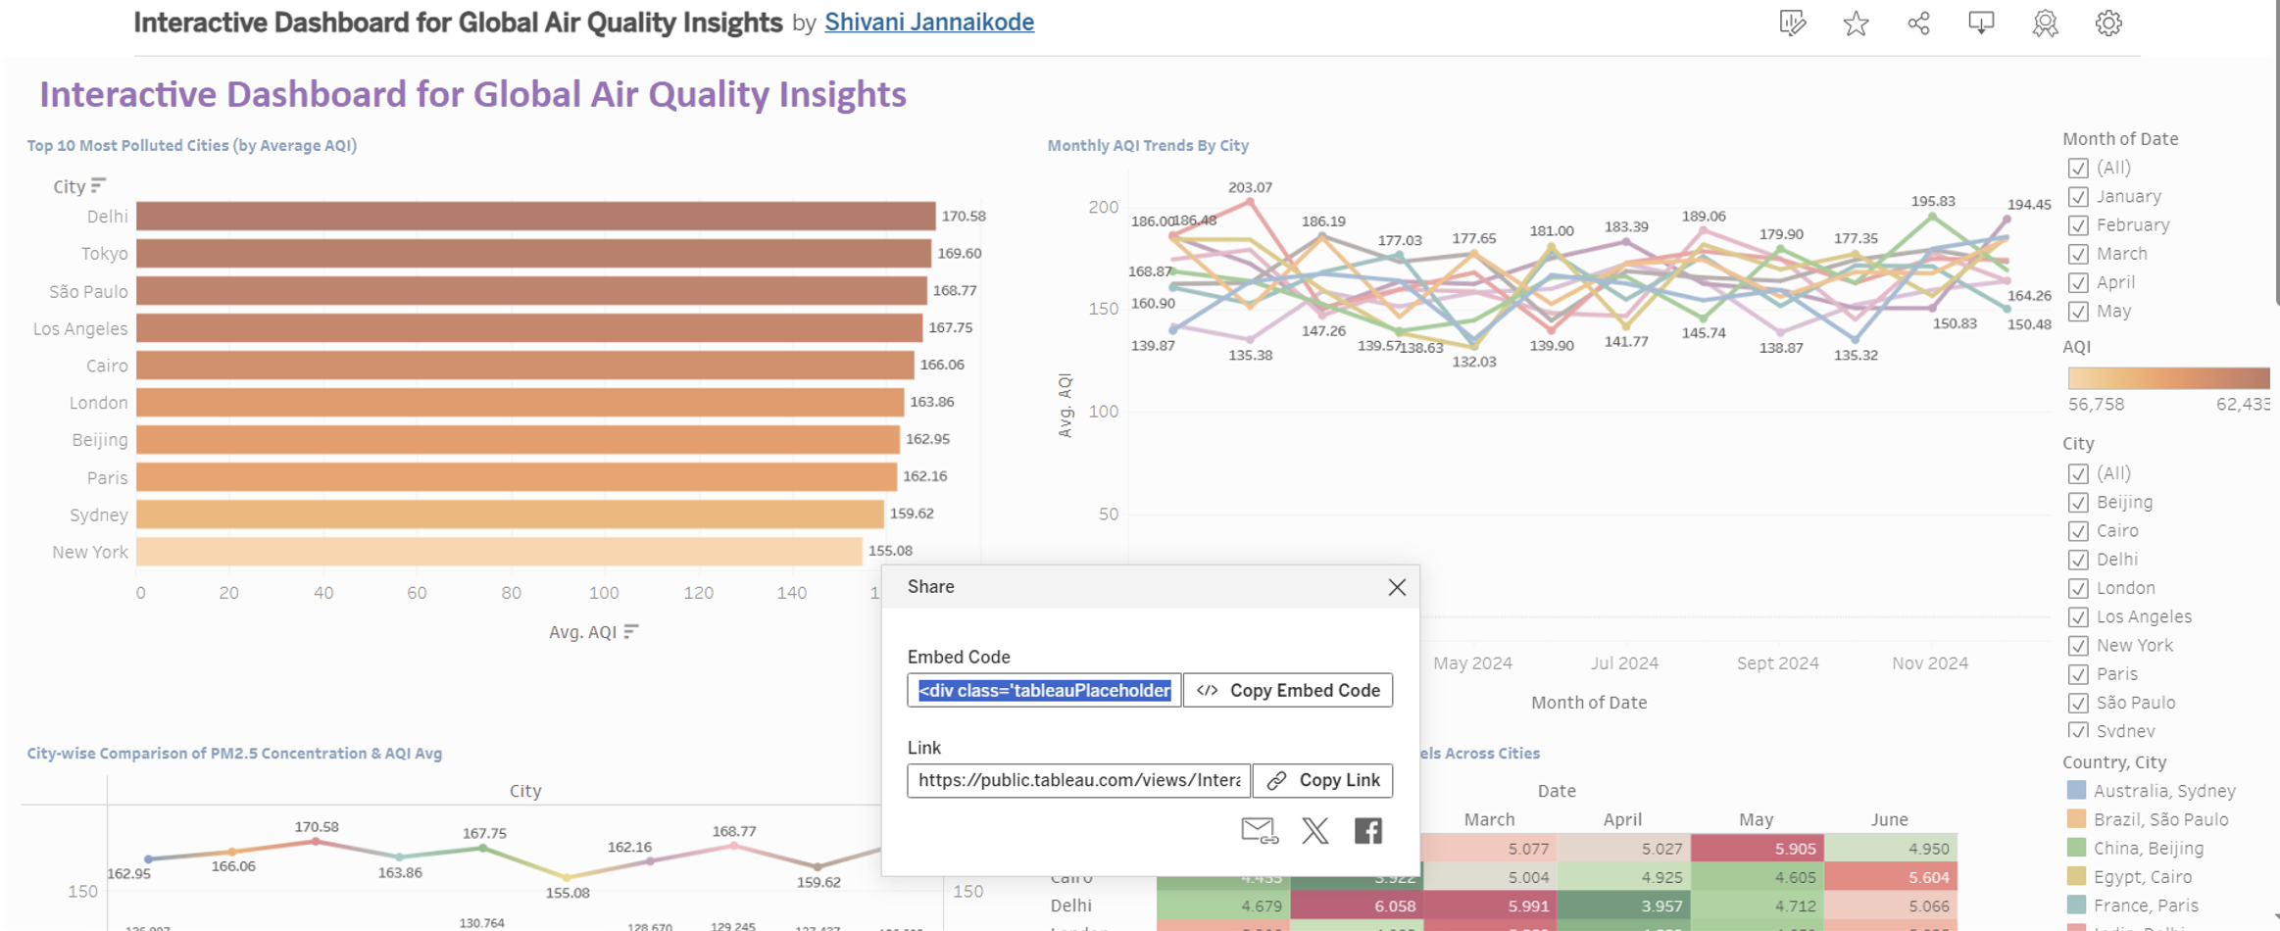
Interactive Dashboard
To meet the webpage integration requirements, an interactive website was developed using HTML, CSS, and JavaScript, with D3.js powering the visualizations for dynamic and responsive data storytelling.
In addition to custom-coded visualizations, a Tableau dashboard was also incorporated to enrich the interactive experience. The dashboard was published to Tableau Public, and the share feature was used to obtain the embed code.
This embed code was seamlessly integrated into the webpage's HTML structure, allowing users to interact with the dashboard directly within the website.
When users click on the "View Interactive Dashboard" button on the homepage, they are presented with the embedded Tableau visualization, enabling smooth and integrated exploration of the dashboard within the same user environment.

Slide 14
Conclusion
This study equips stakeholders with a nuanced understanding of when and where air quality is most compromised, empowering seasonal policies, public health warnings, and urban planning responses to improve living conditions.
Major Insights:
AQI worsens during Fall and Winter seasons globally.
Low Wind + High Humidity = Highest pollution levels observed.
Beijing, Tokyo, Cairo frequently exceed WHO limits for PM2.5, PM10, and O₃.
Historical AQI trends help predict future pollution spikes.
Weekday vs Weekend patterns reveal city-specific traffic pollution issues.
Tools & Technologies:
D3.js, HTML, CSS — Created dynamic, animated charts (Boxplots, Bar charts, Heatmaps, Donut charts).
Tableau Desktop + Public — Interactive dashboards showing city-wise, seasonal pollution patterns.
Impact:
Enables seasonal public health alerts.
Supports urban planning with data-driven policies.
Empowers real-time exploration of pollution trends for researchers, policymakers, and the public.

